Slide 1


A network is a set of branches through which something “flows.”
For example, the branches might be electrical wires through which electricity flows, pipes through which water or oil flows, traffic lanes through which vehicular traffic flows.
Nodes: The branches meet at points, called nodes or junctions, where the flow divides.
Flow Conservation: The rate of flow into any node is equal to the rate of flow out of that node.

Slide 2

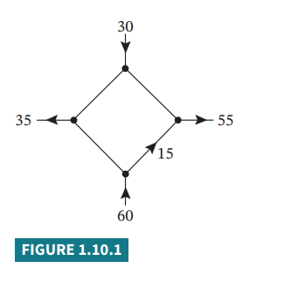

Slide 3
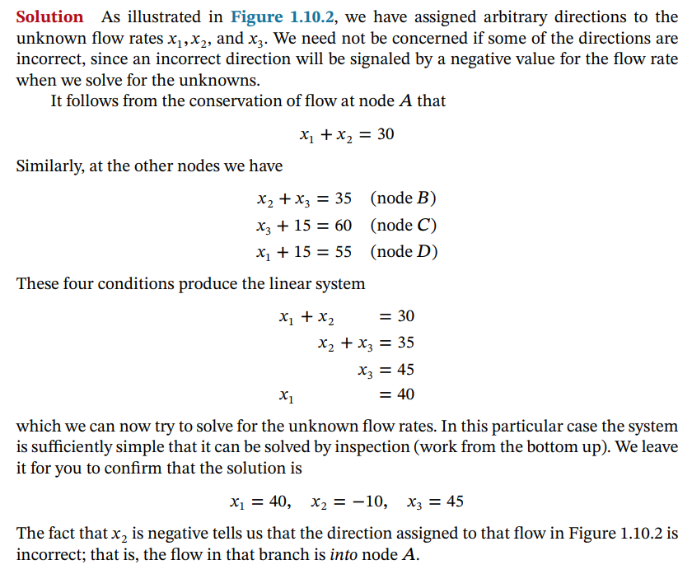
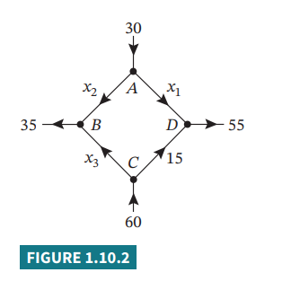

Slide 4

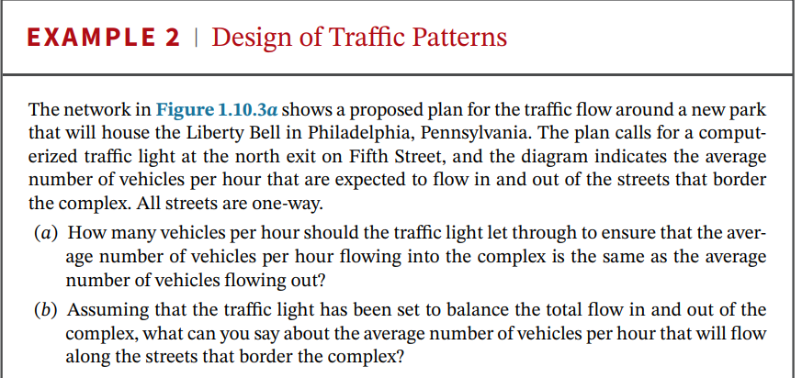
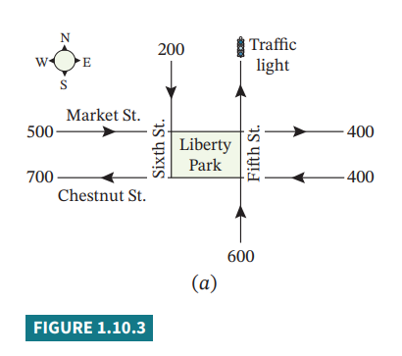

Slide 5
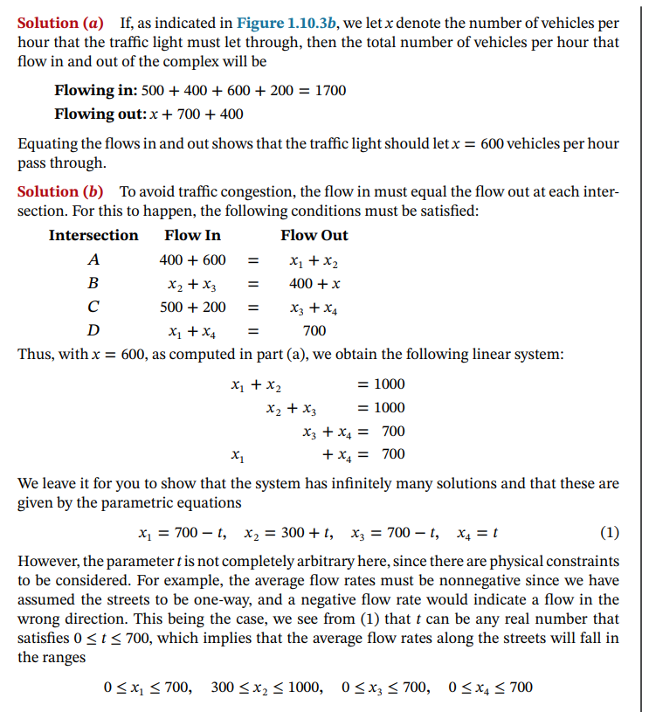
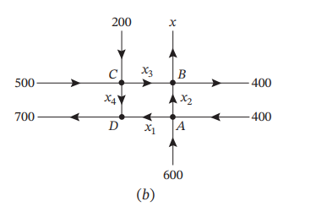

Slide 6
